Slide 1

The Eatwell Guide for children aged 9 – 11 years
How to use this presentation
This presentation can be used to help teach children aged 9-11 years about healthy eating. The presentation is based around the UK healthy eating model – the Eatwell Guide.
How to show the presentation
You can show the PowerPoint as a presentation or print the slides and display or hold them as you talk about healthy eating.
Note: This presentation is more detailed than the 5 – 9 years version. It contains additional information about the food groups, such as the nutrients and fibre. If you need a simpler Eatwell Guide presentation, feel free to use the 5-9 years version.

Slide 2

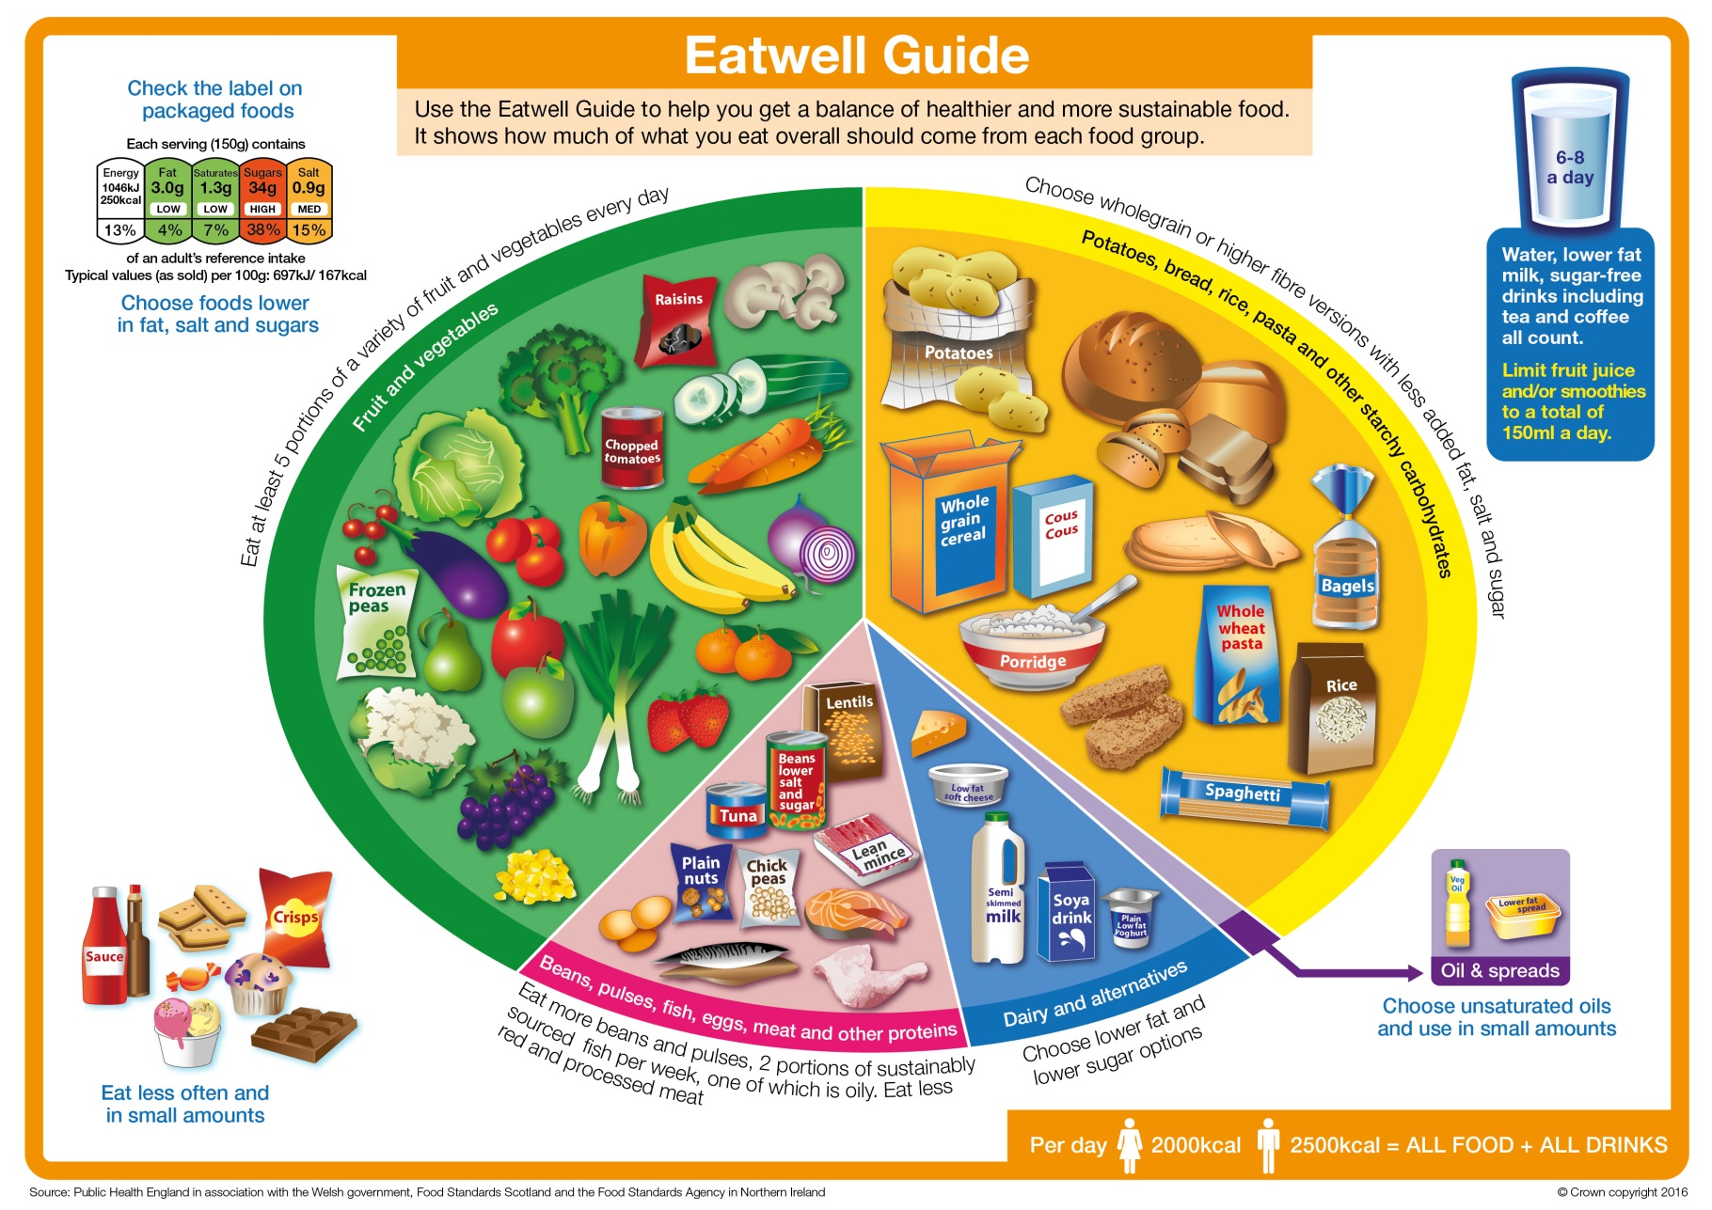
The Eatwell Guide

Slide 3

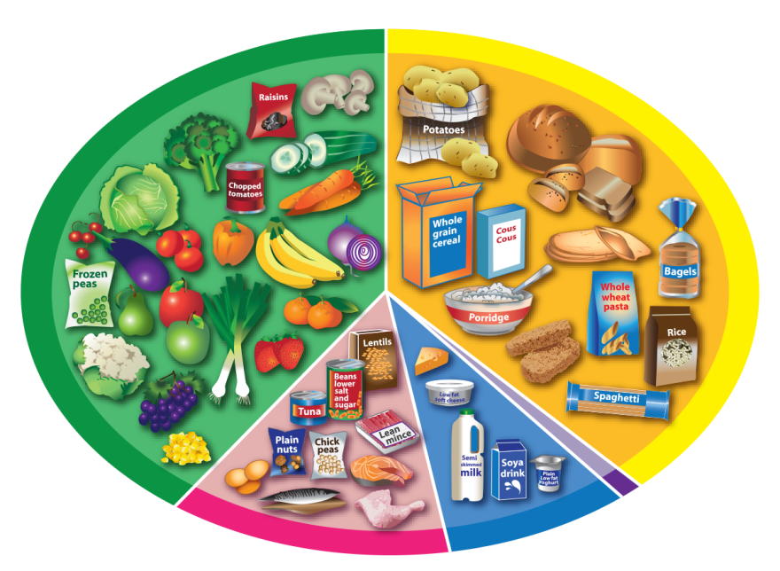

How many food groups can you see?
The Eatwell Guide
Potatoes, bread, rice, pasta and other starchy carbohydrates
Fruit and vegetables
Beans, pulses, fish, eggs, meat and other proteins
Dairy and alternatives

Slide 4

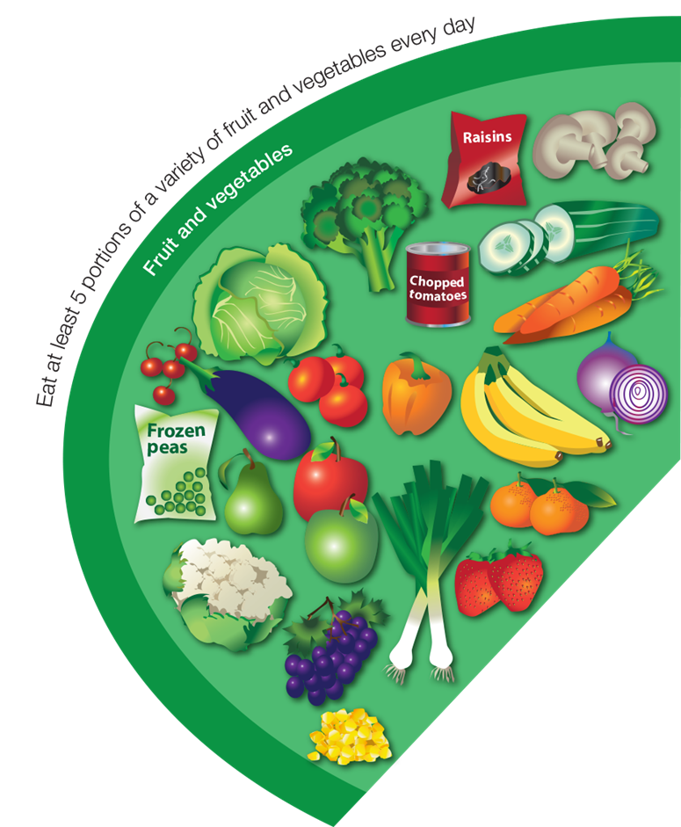

Fruit and vegetables
What foods can you see?
Eat at least 5 portions every day.

Slide 5

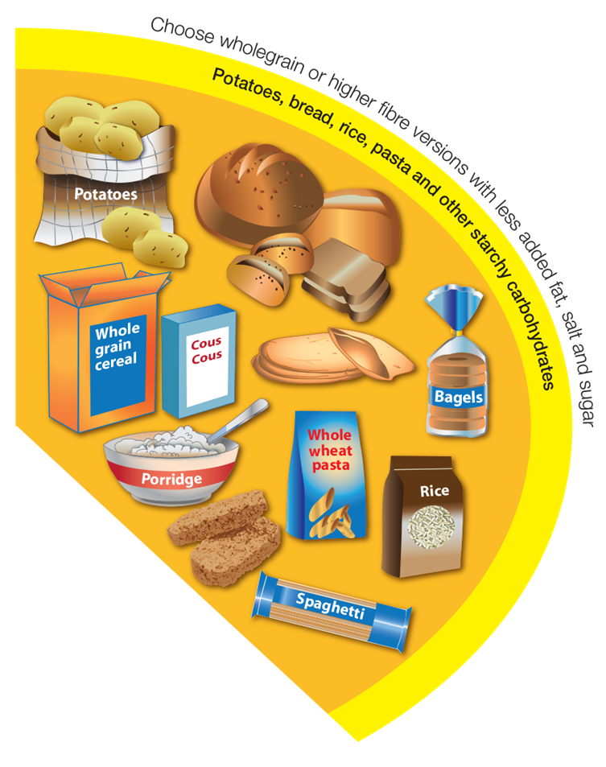

Potatoes, bread, rice, pasta and other starchy carbohydrates
Eat a food from this group at every meal time.
Try wholegrain varieties.
What foods can you see?

Slide 6

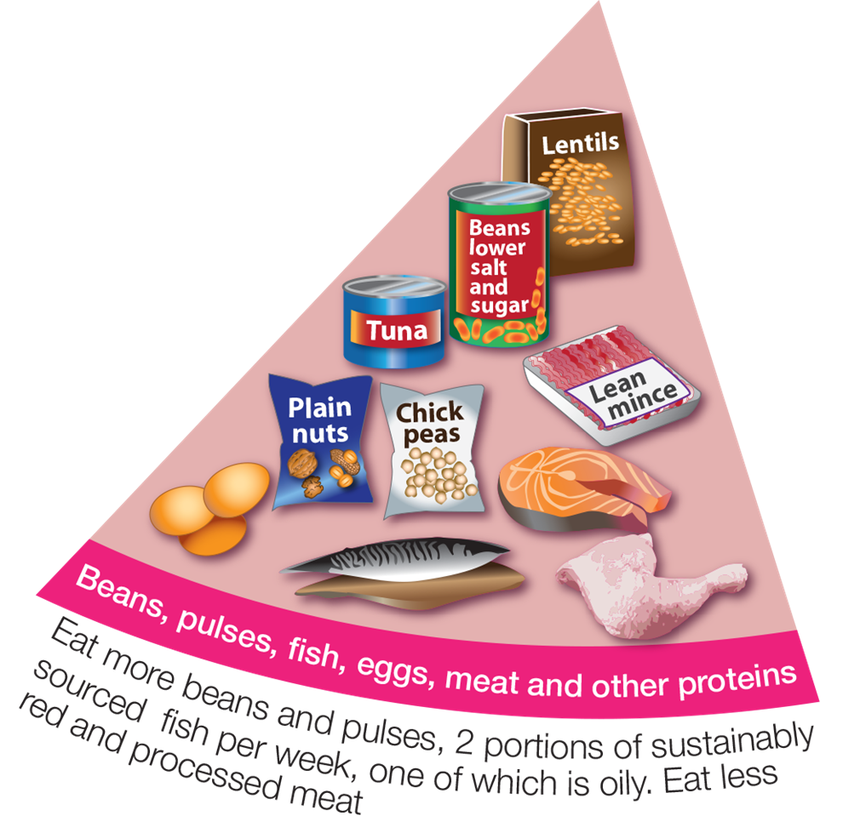

Beans, pluses, fish, eggs, meat and other proteins
What foods can you see?
Eat some foods from this group every day,
e.g. beans on toast and tuna pasta.

Slide 7
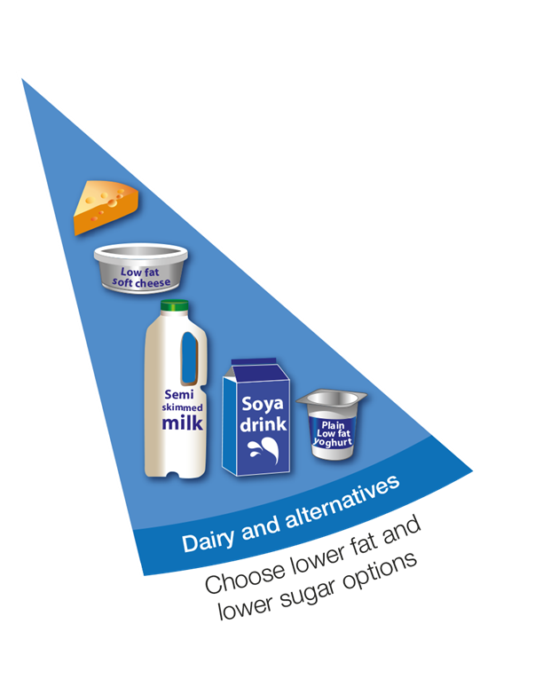
Dairy and alternatives
Have some of these foods every day,
e.g. a pot of yogurt and a cheese sandwich.
What foods can you see?

Slide 8

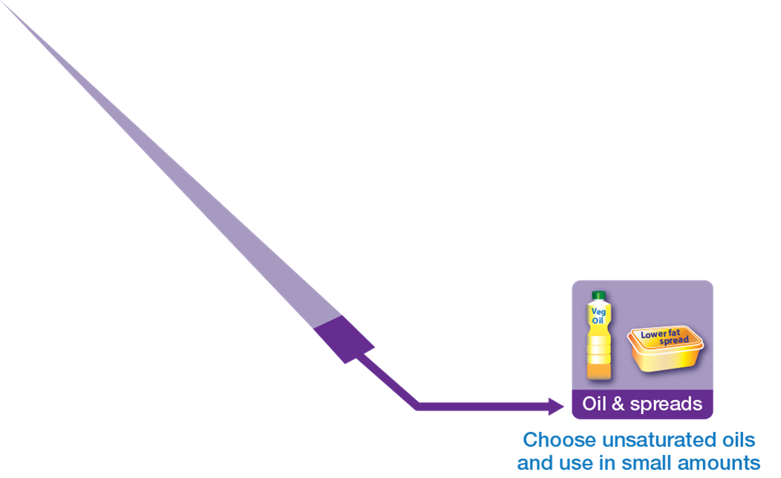
Oil and spreads
What foods can you see?
Eat in small amounts

Slide 9

Foods high in fat, salt and sugars
What foods can you see?
If eaten, have less often and in small amounts.

Slide 10

Drinks
Water and lower fat milk are healthier drink choices!
6-8
a day
You can have 150ml of juice or smoothie a day.

Slide 11
What do you notice about the size of the groups?
The Eatwell Guide
Potatoes, bread, rice, pasta and other starchy carbohydrates
Fruit and vegetables
Beans, pulses, fish, eggs, meat and other proteins
Dairy and alternatives

Slide 12
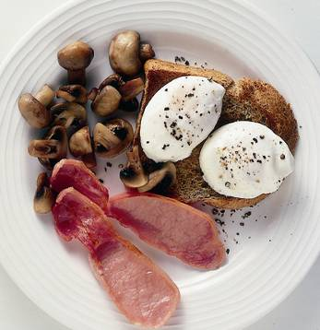
Which food groups are in this meal?
Breakfast
Grilled bacon, poached eggs, wholemeal toast, grilled tomatoes.
Food groups
Fruit and vegetables
Potatoes, bread, rice, pasta and other starchy carbohydrates
Beans, pulses, fish, eggs, meat and other proteins
Dairy and alternatives
Oils and spreads

Slide 13
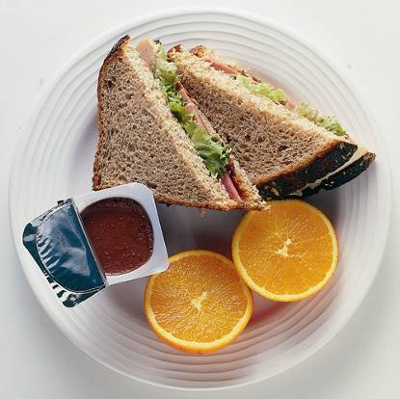
Which food groups are in this meal?
Lunchbox
Ham and salad sandwich, orange, chocolate mousse.
Food groups
Fruit and vegetables
Potatoes, bread, rice, pasta and other starchy carbohydrates
Beans, pulses, fish, eggs, meat and other proteins
Dairy and alternatives
Oils and spreads
How would you make it healthier?

Slide 14

Nutrients

Slide 15
Nutrients
What are the main nutrients provided by the
five food groups?
Potatoes, bread, rice, pasta and other starchy carbohydrates
Fruit and vegetables
Beans, pulses, fish, eggs, meat and other proteins
Dairy and alternatives
What does each nutrient do?

Slide 16
Fruit and vegetables
Vitamins are needed for good health.
Vitamin C helps keep the cells in our body healthy and helps wounds heal.
Vitamins,
e.g. vitamin C.

Slide 17
Potatoes, bread, rice, pasta and other starchy carbohydrates
Carbohydrate provides energy.
Carbohydrate

Slide 18
Beans, pluses, fish, eggs, meat and other proteins
Protein
Protein is needed for growth and repair of muscles.

Slide 19
Dairy and alternatives
Minerals are needed for good health.
Calcium helps build strong bones and teeth.
Minerals,
e.g. calcium

Slide 20
Oil and spreads
Fat is needed for general good health and helping us absorb some vitamins.
Fat

Slide 21
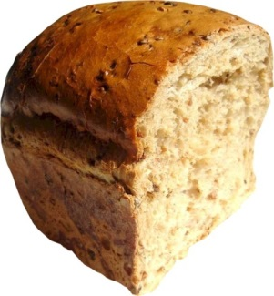
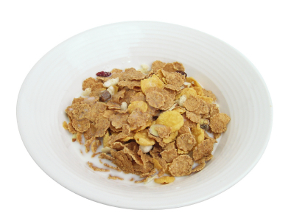
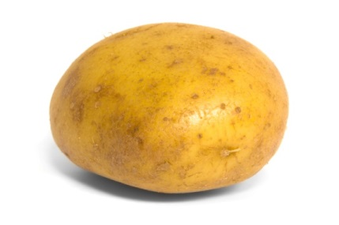
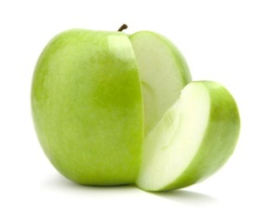
Fibre
Fibre is not a nutrient but is important for health.
Fibre is needed to keep food moving through the body so the digestive system stays healthy.
We can get fibre from…
Fruit and vegetables
Wholegrain foods

Slide 22
© Warburtons 2016

